Slide 1
C++ Development Environment in Linux
Sampath Amarasinghe

Slide 2
Our Team
Sampath Amarasinghe
Upul Kumara
Kasun Sameera
Samitha Senarathna

Slide 3

Contents
Basic Tools
vim
cscope
Compilation Tools
g++
Error Detection Tools
GDB
Valgrind
Other Linux Utilities

Slide 4

VIM

Slide 5
VIM - overview
Introduction
Why vim?
.vimrc file
demonstration on useful and frequently used commands in vim

Slide 6
vim
Introduction - What is vim?
Vim is a text editor that is usually found under Unix, Linux and other open-source OS environments.
Vim has two main modes: insert mode and command mode. When you start Vim, you’re in the latter “command mode”.
Command mode allows you to execute vim commands.
Insert mode allows you to type text into the editor as it is in other editors(note pad, word pad, gedit etc.)
Why Vim?
Has both advantages and disadvantages.
Advantages – packed with powerful text editing features, available in almost every platform.
Disadvantages – large learning curve, lack of code completion facilities. (has to install separate plugins to achieve this – e.g. omnicppcomplete )
Once mastered, vim enhance your productivity.
A GUI version of vim is available called ‘gvim’ (graphical vim)

Slide 7
vim
.vimrc file
.vimrc file contains configuration settings to initialize when it starts. Normally it is located in home directory.
Demonstration
Some frequently used and useful vim commands will be demonstrated along with the usage of .vimrc file.
References for further study
http://vim.wikia.com/wiki/Vim_Tips_Wiki
http://www.linux.com/learn/tutorials/228600-vim-101-a-beginners-guide-to-vim
http://www.yolinux.com/TUTORIALS/LinuxTutorialAdvanced_vi.html
vimtutor program in Linux

Slide 8
CSCOPE

Slide 9
cscope - overview
Introduction
Available functionalities
Steps on setting up scope
Useful and common options
Demonstration using an example program

Slide 10
cscope
Purpose : used to browse source code.
cscope is an interactive, screen-oriented tool that allows the user to browse through C/C++ source files for specified elements of code.
Functionalities - Allows searching code for finding….
Global definitions
Functions called by a function.
Functions calling a function.
Text string
a file and few others….
Steps
Creates a file called sources.files which contains all the file names in the current project.
find . -name "*.cpp" -o -name "*.h" -o -name "*.c" > sources.files
Create the cscope database and run. [following command will create a file called csocpe.out]
cscope sources.files

Slide 11
cscope
Frequently used cscope options
-q Enable fast symbol lookup via an inverted index. This option causes cscope to create 2 more files (default names ``cscope.in.out'' and ``cscope.po.out'') in addition to the normal database. This allows a faster symbol search algorithm that provides noticeably faster lookup performance for large projects.
-b build cross-reference data only but does not start the Cscope browser.
-R recursively search subdirectories for source files.
-i <file name> include source files.
CSCOPE_EDITOR variable
Use this if you wish to use a different editor with cscope. It is very common that using gvim as the cscope editor in Atrenta.
setenv CSCOPE_EDITOR gvim
Demonstration note
Use tabs to switch between file area and input area.
Ctrl+D for exit.

Slide 12
cscope
How database is updated when a particular file is changed by user.
cscope builds the symbol cross-reference the first time it is used on the source files for the program being browsed. On a subsequent invocation, cscope rebuilds the cross-reference only if a source file has changed. When the cross-reference is rebuilt, the data for the unchanged files are copied from the old cross-reference, which makes rebuilding faster than the initial build.
References for further study
http://cscope.sourceforge.net/cscope_man_page.html
https://courses.cs.washington.edu/courses/cse451/12sp/tutorials/tutorial_cscope.html
http://mylinuxbook.com/cscope/

Slide 13
g++

Slide 14
g++ - overview
Introduction
Different steps in compilation
Commands
Useful and common options
Demonstration using an example program

Slide 15
g++ Compiler
What is g++?
g++ is a program that will take your C++ source code and compile it into a binary file that can be executed to actually run your program.
Different steps in compilation
Preprocessing
preprocessor expands all those macros definitions and include statements (and anything else that starts with a #). The output of is just C++ code.
Compilation
The compiler effectively translates preprocessed C++ code into assembly code, performing various optimizations. Since a compiler generates assembly code specific to a particular architecture, you cannot use the assembly output of one architecture in another architecture.
Assembling
The assembly code generated by the compilation step is then passed to the assembler which translates it into machine code; the resulting file is called an object file. An object file is a binary representation of your program. A typical object file contains the program text (instructions) and data (constants and strings), information about instructions and data that depend on absolute addresses, a symbol table of unresolved references, and possibly some debugging information.

Slide 16
g++ Compiler
Different steps in compilation ctd…
Linking
The linker produces a binary executable that can be run from the command interface by linking (resolving all the references) all the object files generated in the previous step.
commands
Preprocessing ; do not compile, assemble or link
g++ -E hello.cpp –o hello.ii
Compilation ; Compile only; do not assemble or link
g++ -S hello.cpp –o hello.s
Assembling ; Compile and assemble, but do not link
g++ hello.cpp –o hello.o
Linking ; compile, assemble and link
g++ hello.cpp –o hello
How to get all the intermediate files
g++ hello.cpp –o hello –save-temps

Slide 17
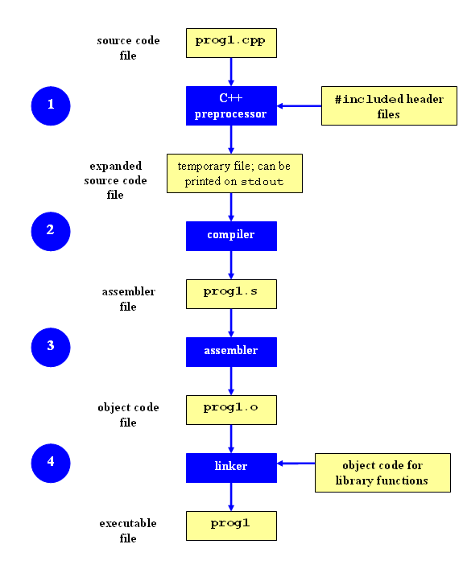
g++ Compiler
Graphical View

Slide 18
g++ Compiler
Frequent compiler options
-Wall flag will show ALL the warning messages you may get that describe possible errors in your source code. If warnings are the only messages you receive when you compile your source code, and executable will still be created. Only if there are ERROR messages will an executable not be created.
g++ optimizations
-O1 only perform basic optimizations.
-O2 performs deep optimizations. it is balanced between code size and speed.
Demonstration
Different steps of the compilation process will be demonstrated.
Note : Compiling your source code files can be tedious, specially when you want to include several source files and have to type the compiling command every time you want to do it. It is very common to use the makefile utility for compilation specially for large projects. We uses makefiles for simplify our complex compilation process.

Slide 19
g++ Compiler
References for further study
https://courses.cs.washington.edu/courses/cse378/98wi/help/compilation.html
http://www.ntu.edu.sg/home/ehchua/programming/cpp/gcc_make.html

Slide 20
GDB

Slide 21
GDB - overview
Need for debugging
Common errors
Internal details
Demonstration using an example program

Slide 22
GDB (GNU debugger)
What is the need of debugging?
Before a bug can be fixed, the source of the bug must be located. For example, with segmentation faults, it is useful to know on which line of code the segmentation fault is occurring. Once the line of code in question has been found, it is useful to know about the values in that method, who called the method, and why (specifically) the error is occurring. Using a debugger makes finding all of this information very simple.
GDB is the debugger used in Atrenta for the above mentioned requirement.
There are four common mistakes that lead to segmentation faults.
dereferencing NULL
dereferencing an uninitialized pointer
dereferencing a pointer that has been freed (or deleted, in C++) or that has gone out of scope (in the case of arrays declared in functions)
writing off the end of an array.
The strategy for debugging all of these problems is the same: load the core file into GDB, do a backtrace, move into the scope of your code, and get an idea on what caused the segmentation fault.

Slide 23
GDB (GNU debugger)
How GDB works internally?
When used -ggdb or -g option, g++ creates additional information about the program and deposits it in a symbol table. The debugger must have this symbol table to do its work.
A Symbol Table maps instructions in the compiled binary program to their corresponding variable, function, or line in the source code. This mapping could be something like: Program instruction => item name, item type, original file, line number defined.
So if you plan to debug your program then it is required to create Symbol table which will have required information to debug the program.
A symbol table works for a particular version of the program –if the program changes, a new table must be made.
Debug builds are often larger and slower than non-debug builds; debug builds contain the symbol table and other information.
If you wish to debug a binary program you did not compile yourself, you must get the symbol tables from the author.
To let GDB be able to read all that information line by line from the symbol table, we need to compile it a bit differently as mentioned above.

Slide 24
GDB (GNU debugger)
Demonstration (example code is provided)
Run program and see the segmentation fault.
Run gdb and identify problematic line.
Examine stack and get more information.
Add breakpoints to determine the root cause for the issue.
Run program and When hit a breakpoint open graphical view and go step by step.
determine root cause for the issue and fix.
You will see most of the frequently used gdb commands in this demonstration.
References for further study
https://www.sourceware.org/gdb/onlinedocs/gdb.html
http://www.cs.uregina.ca/Links/class-info/330/CompileDebug/

Slide 25
Valgrind

Slide 26
Valgrind - overview
What is Valgrind?
What is Valgrind for?
Basic tools in Valgrind
Valgrind usage in Atrenta
Demonstration using an example program

Slide 27
Valgrind
What is Valgrind?
Valgrind is an instrumentation framework for building dynamic analysis tools. There are Valgrind tools that can automatically detect many memory management and threading bugs, and profile your programs in detail.
What is Valgrind for?
Valgrind is well-known as a tool for finding errors of work with memory. But except this, it also contain number of additional utilities for performance profiling, finding synchronization errors in multi-threading programs and analysis of memory consumption.

Slide 28
Valgrind
Basic tools in Valgrind
Memory error detection
Ptrcheck
Memcheck
Thread error detection
Helgrind
DRD
Proilers
Cachegrind
Callgrind
Massif

Slide 29
Valgrind
Valgrind usage at Atrenta
Memcheck
Illegal reads
Illegal writes
Conditional jumps
Memory leaks
Example : Running valgrind
Set valgrind options
VALGRIND_OPTS=--tool=memcheck --leak-check=full --leak-resolution=high --num-callers=18 --log-file=valgrind.out.pid
Compile the program in debug mode
g++ -g main.cpp
Run compiled program with valgrind
valgrind ./a.out
Check the valgrind.out.pid file to find the issues in the program.

Slide 30
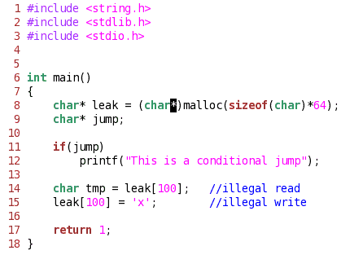
Valgrind
Simple erroneous program

Slide 31
Valgrind
Simple erroneous program – Analysis
Conditional jump
==4918== Conditional jump or move depends on uninitialized value(s)
==4918== at 0x80484B8: main (main.cpp:11)
Invalid read
==4918== Invalid read of size 1
==4918== at 0x80484CC: main (main.cpp:14)
==4918== Address 0x402408C is not stack'd, malloc'd or (recently) free'd
Invalid write
==4918== Invalid write of size 1
==4918== at 0x80484D8: main (main.cpp:15)
==4918== Address 0x402408C is not stack'd, malloc'd or (recently) free'd
Memory leak
==4918== 64 bytes in 1 blocks are definitely lost in loss record 1 of 1
==4918== at 0x40053C0: malloc (vg_replace_malloc.c:149)
==4918== by 0x80484B0: main (main.cpp:8)

Slide 32
Valgrind
References for further study
http://valgrind.org/docs/manual/index.html
http://en.wikipedia.org/wiki/Valgrind

Slide 33
OTHER lINUX UTILITIES

Slide 34
Other Linux Utilities
Path variable
PATH is an environmental variable in Linux that tell the shell which directories to search for executable files in response.to commands issued by the user.
Process related
ps, kill, top, bg
File related
ls , ll, tree
Searching
grep, find
Other
alias, which
Output redirection and pipe
Demonstration includes:
Usage of above commands.
How to implement your own commands.

Slide 35
unihelpdesk@atrenta.com

Slide 36
Thank you!

